Slide 1


ICTSAS432 - Identify and resolve client ICT problems
Session 1

Slide 2
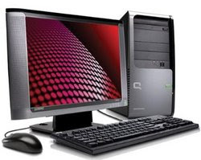
Modern PC hardware components
A modern computer consists of several visible components such as mouse, keyboard, system unit or case, and the LCD screen.

Slide 3
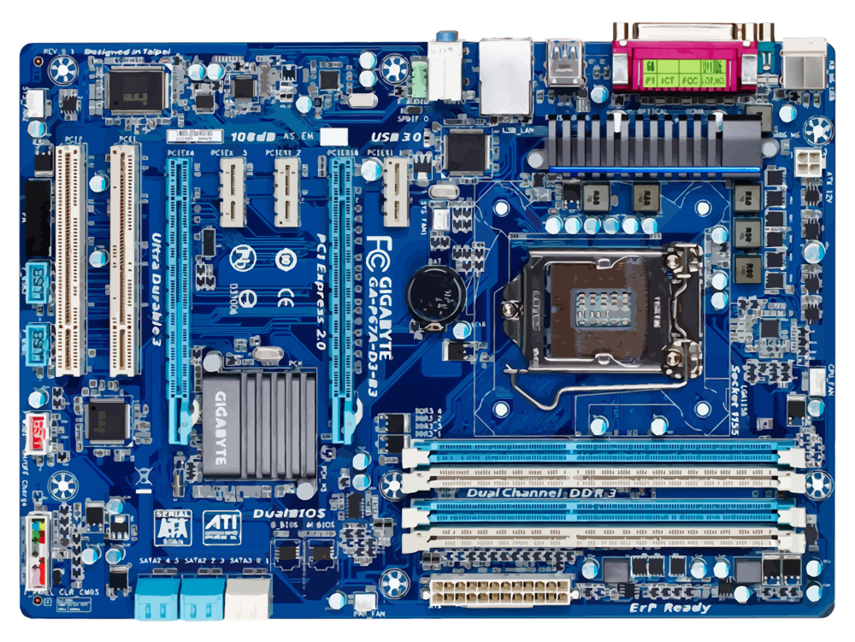
Motherboard
A computer system also consists of several internal hardware components as follows:
The Motherboard is the base for all of the components that make the PC work.

Slide 4
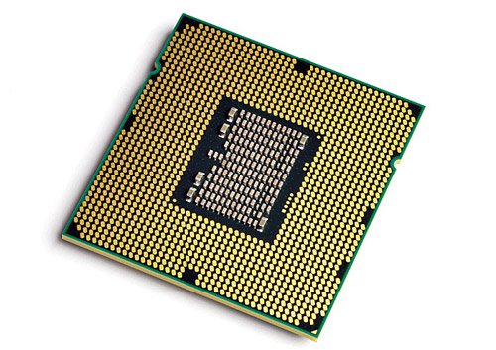
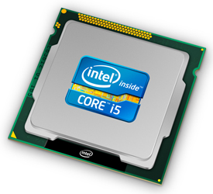
Cpu processor
CPU processors come in a variety of speeds and Cores.
A CPU core, is the "brain" of a CPU. It receives instructions, and performs calculations, or operations, to satisfy those instructions.
A CPU can have multiple cores. A processor with two cores is called a dual-core processor; with four cores, a quad-core; six cores, hexa-core; eight cores, octa-core.

Slide 5
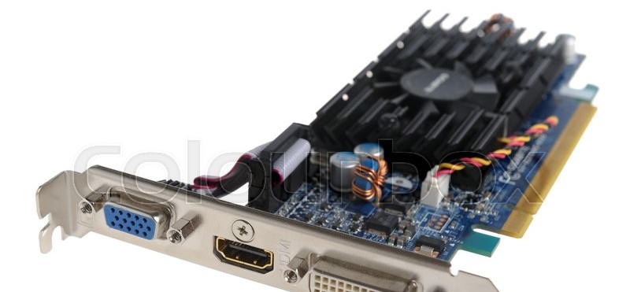
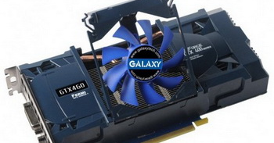
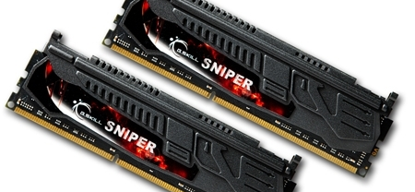
Graphics or VGA cards
A graphic card is a computer component that renders images, videos, 3D graphics and animation to your monitor. Usually, the graphic card is mounted in a slot of the motherboard
Memory or RAM
RAM (Random Access Memory) is the hardware in a computing device where the operating system (OS), application programs and data in current use are kept so they can be quickly reached by the device's processor. RAM is the main memory in a computer.

Slide 6
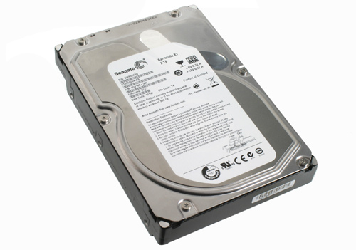
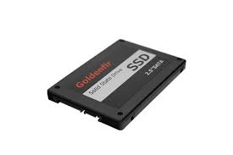
Hard Drive (HDD)
A hard disk drive (HDD), is an electro-mechanical data storage device that stores and retrieves digital data using magnetic storage with one or more rigid rapidly rotating platters coated with magnetic material. Data is accessed in a random-access manner, meaning that individual blocks of data can be stored and retrieved in any order.
Solid State Drive (SSD)
A solid-state drive (SSD) is a solid-state storage device that uses integrated circuit assemblies to store data persistently, typically using flash memory, and functioning as secondary storage in the hierarchy of computer storage. It is also sometimes called a semiconductor storage device, a solid-state device or a solid-state disk

Slide 7

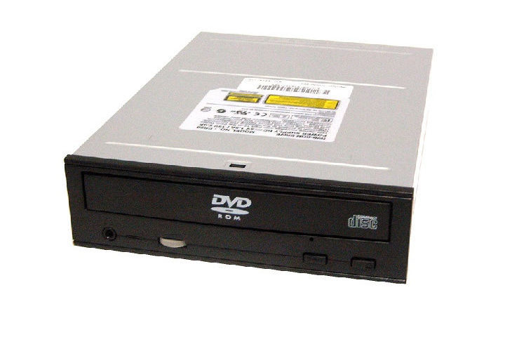
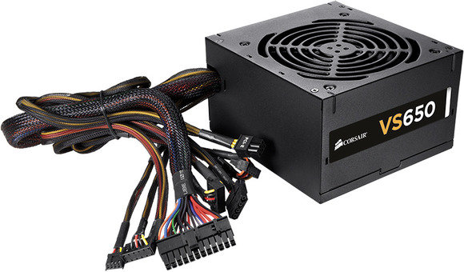
CD Rom / DVD Drives
Compact Disc read-only memory) is a pre-pressed optical compact disc that contains data. Computers can read—but not write or erase—CD-ROMs,
Power Supply (PSU)
A power supply unit (PSU) converts mains AC to low-voltage regulated DC power for the internal components of a computer. Modern personal computers universally use switched-mode power supplies. Some power supplies have a manual switch for selecting input voltage, while others automatically adapt to the mains voltage.

Slide 8
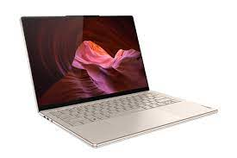
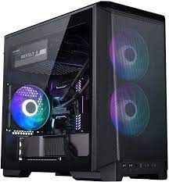
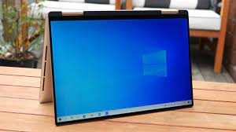
Computer case or chassis
Where all the components reside
Can come in various sizes and shapes from towers to compact desktops, laptops and tablets

Slide 9
The different types of computer cables
Take a look at any piece of equipment related to computer hardware and you’ll soon find yourself in a swirling maelstrom of acronyms and foreign jargon.
What does it matter if you use IDE or SATA for your hard drive?
Is SATA related to SAS?
Do you really need to know the differences between USB 1.0, 2.0, and 3.0?
Is FireWire related to Firewall?
Abbreviations are thrown around in product descriptions without much regard for the user’s understanding their meanings. In the end, the responsibility is left to the consumer to learn all of the different types of cables before making a solid decision.
With so many types of cables, however, it’s hard to find a singular source of information that highlights the important differences between them all. Here’s an overview of the most common computer cable types you’ll encounter when dealing with computers.

Slide 10
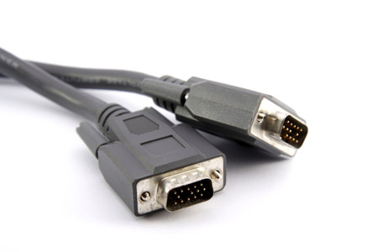
VGA (Video Graphics Array)
Created way back in the 1980’s, the VGA connection cable was the standard cable used to connect a computer to a monitor. More recently, it has faded out of popularity due to the gradual shift towards digital connections over analog. Still, if you look on any video card or display apparatus, there is a good chance you’ll see a VGA port.
VGA connections can be identified by 15 pins arranged in 3 rows with 5 on each row. Each row corresponds to the 3 different color channels used in display: red, green, and blue.

Slide 11
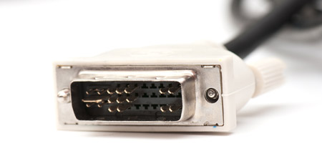
DVI (Digital Visual Interface)
The DVI connection became the successor to VGA as technology moved away from analog towards digital. Digital displays, like LCD, proved to be higher quality, which soon became the market standard for home pictures. DVI connectors come in 3 varieties.
DVI-A can transmit analog signals, allowing it to be backwards compatible with VGA (useful for CRT monitors and LCDs of lower quality).
DVI-D can transmit the newer digital signals.
DVI-I is capable of both analog and digital.
In certain cases, you may need a VGA-to-DVI or DVI-to-VGA converter cable.

Slide 12
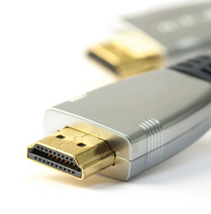
HDMI (High Definition Multimedia Interface)
In the past decade, high-definition broadcasts became the new standard of what it means to be high quality. Unlike VGA and DVI, HDMI sends both video and audio signals together. The signals are digital only; thus, HDMI is only compatible with newer devices.
HDMI connectors come in 4 types:
Type A is the most popular. This connector can be identified by its 19 pins on the male head. Type A is compatible with single-link DVI-D connections.
Type B is larger than Type A, coming in at 29 pins on the male head. Type B is compatible with dual-link DVI-D connections.
Type C is a 19-pin connector that’s most often used with portable devices, like camcorders and digital cameras.
Type D looks similar to a micro-USB cord. It also has 19 pins.

Slide 13
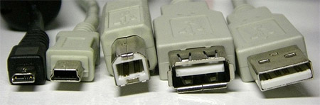
USB (Universal Serial Bus)
From left to right: micro USB, mini USB, type B standard USB, and type A standard USB (both female and male).
Nearly every form of computer peripheral device — keyboards, mice, headsets, flash drives, wireless adapters, etc. — can be connected to your computer through a USB port. The design has evolved over the years, which means there are multiple versions of USB available:
USB 1.0/1.1 can transmit data at speeds up to 12 Mbps.
USB 2.0 can transmit data at speeds up to 480 Mbps and is compatible with older versions of USB.
USB 3.0 can transmit data at speeds up to 4.8 Gbps. It is compatible with previous versions of USB.
The mini and micro USB variants are most often used with smaller, portable devices like PDAs, phones, and digital cameras. The standard USB connectors are more often used on devices that tend to remain plugged in, like external hard drives, keyboards, and mice.

Slide 14
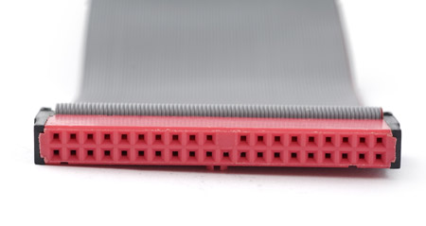
IDE (Integrated Drive Electronics)
IDE cables were used to connect storage devices to a motherboard. If you’ve ever opened up an old computer with an old hard drive then you likely know what an IDE connector looks like. It’s the wide cable that looks like a ribbon with more than 2 plugs.
The connectors on an IDE cable have 40 pins; the smaller 2.5” drive variety uses a form-factor version of the IDE that has 44 pins.

Slide 15
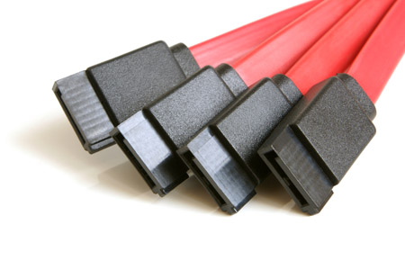
SATA (Serial Advanced Technology Attachment)
Newer hard drives will likely use SATA ports over IDE ports. In fact, SATA was designed to succeed IDE, and it has. Compared to IDE, SATA provides higher data transfer speeds. Your motherboard needs to be compatible with SATA, and nowadays most of them are.
A standard SATA cable can be identified by two connectors, each having 7 pins and an empty notch. It looks like a subtle L-shape.

Slide 16
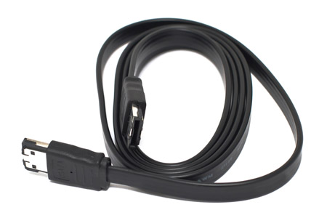
SATA (External Serial Advanced Technology Attachment)
eSATA technology is an extension of, or improvement on, the SATA cable — it makes SATA technology available in an external form. In reality, eSATA is not much different from SATA, but it allows connections to devices like external hard drives and optical drives. This is useful because eSATA offers speeds much faster than most FireWire and USB alternatives.

Slide 17
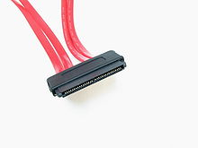
SAS (Serial Attached SCSI)
SAS or Serial Attached SCSI [Small Computer Systems Interface] is likely to be encountered in SOHO and small business environments as an enterprise or premium offering in high end servers, workstations, and SAN or NAS equipment. SAS hard drives are roughly twice the price and are generally a smaller capacity to SATA drives, however they are to four times faster. SAS-4 hard drives can operate at a transfer speed of 24 Gbps compared to SATA 3 version hard drives operating at a transfer speed of 6 Gbps.
SAS connectors are also available as external connectors, noting that the connector is a square form factor as opposed to the above internal connector in a ribbon form factor.

Slide 18
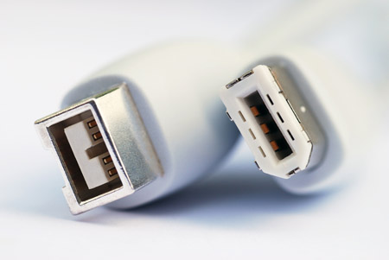
FireWire
The purpose of FireWire is similar to that of USB: high speed data transfer for computer peripherals. High bandwidth devices, like printers and scanners, will benefit from FireWire. For whatever reason, FireWire is not as widespread as USB. FireWire cables come in two forms: 1394a (which has a transfer speed of 400 Mbps) and 1394b (which has a transfer speed of 800 Mbps).

Slide 19
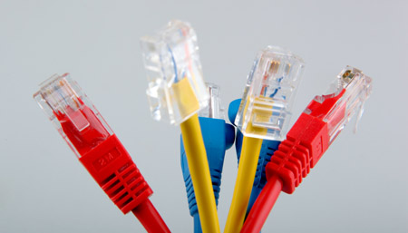
Ethernet
Ethernet cables are used to set up local area networks. In most cases, they’re used to connect routers to modems and computers. If you’ve ever tried to install or fix a home router, you’ve likely dealt with an Ethernet computer cable. Nowadays, they come in three varieties:
Cat 5 cables are the most basic type and provide speeds of either 10 Mbps or 100 Mbps.
Cat 5e, which means Cat 5 Enhanced, allows for faster data transmission than its predecessor. It caps at 1,000 Mbps.
Cat 6 is the latest and offers the best performance of the three. It’s capable of supporting 10 Gbps speeds.
These cables comprise about 99% of all the cables you’re likely to find lying around in your home or in a small business.

Slide 20
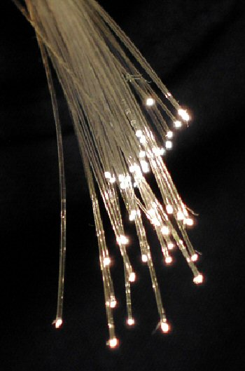
Fiber Optic Cable
Fiber-optic internet, commonly called fiber internet or simply “fiber,” is a broadband connection that can reach speeds of up to 940 Megabits per second (Mbps), with low lag time. The technology uses fiber-optic cable, which amazingly can send data as fast as about 70% the speed of light.
Fiber comes in two modes
SMF (Single Mode Fiber)

Slide 21
Fiber Optic Cable
Fiber comes in two modes
SMF (Single Mode Fiber) cable speed, no matter data rate is at 100 Mbit/s or Gbit/s, the transmission distance can reach up to 5 km. In that case, it is usually used for long distance signal transmission.
MMF (Multimode) Multimode fiber provides higher bandwidth at higher fiber optic cable speed. It is mostly used for short distance communication, such as within a building or on a campus. Typically, the multimode fiber optic cable speed and the transmitting distance limits are 100 Mbit/s for distance up to 2 km (100BASE-FX), Gbit/s up to 1000m, and 10 Gbit/s up to 550 m.

